Slide 1
CUSTOMER SATISFACTION For Restaurants BASED ON THE Parameters FOR THE BUSSINESS DEVELOPMENT And Revenue
Under the Guidance of
Mrs. Uma. M
1201310056 Mohit Ratnesh
1201310057 Sourabh Agarwal

Slide 2
Introduction
The customer satisfaction is key goal to achieve by any business individual to increase their business and development.
In the restaurant business the key to achieve customer satisfaction is affected by many parameters.
This parameters includes like food quality, service, locality and Etc.
Therefore by using data mining techniques we can analyze or determine the customer satisfaction for different parameters.

Slide 3
Existing System
In the existing systems there are many kind of websites and apps that provide customer satisfaction results, Based on the reviews provided by the customers.
Companies like zomato, Just Dial, and many more provide the reviews based on the customer reviews.

Slide 4
Disadvantage
The websites or apps like zomato and related companies provide reviews based on the customers feedback but does not predict whether customers will come back again or not.
There are many proposed theories but very few of them is been converted to the application.

Slide 5
Proposed System
The application proposed here is the software that will take the feedbacks from the customers.
The feedbacks the will be compared to the previously data mined data sets of the other restaurants on different parameters.
Then it will predict the output for the customer may return or comes back to restaurant again for eating.

Slide 6
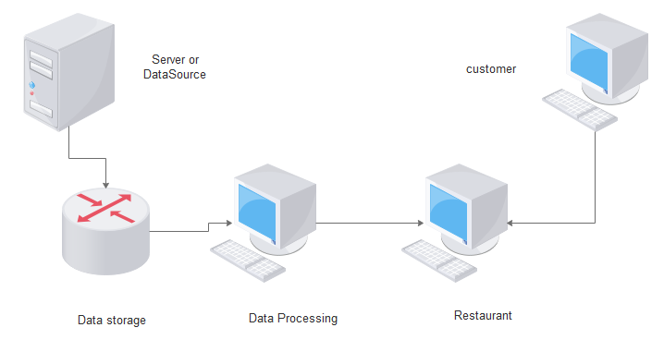
Architecture Diagram

Slide 7
Modules
The Modules for this application is mainly divided in 3 parts
The Data Sets
The weka Tool for Data mining
Feedback module.

Slide 8
Algorithm
The algorithm used in this application for data mining technique is J-48 in weka tool.
This is a decision tree algorithm which follows a univariate approach.
This algorithm is an extension of ID3 algorithm and possibly creates a small tree. It uses a divide and conquers approach to growing decision trees that was leaded by Hunt and his co-workers (Hunt, Marin and Stone, 1966).
It has mainly 2 parts counting information gain and pruning.

Slide 9
Advantages
The application will help to increase the business and revenue of the restaurants.
The application will also help to determine the new schemes for their regular ordering customers.
The application can also help In determining the eating pattern of the customers and can help to determine their customer orders.

Slide 10
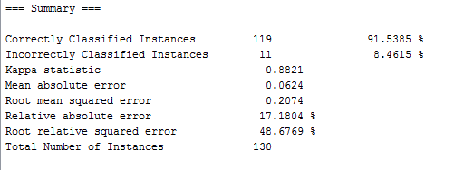
Result Analysis
The data sets when data mined gave the results as following

Slide 11
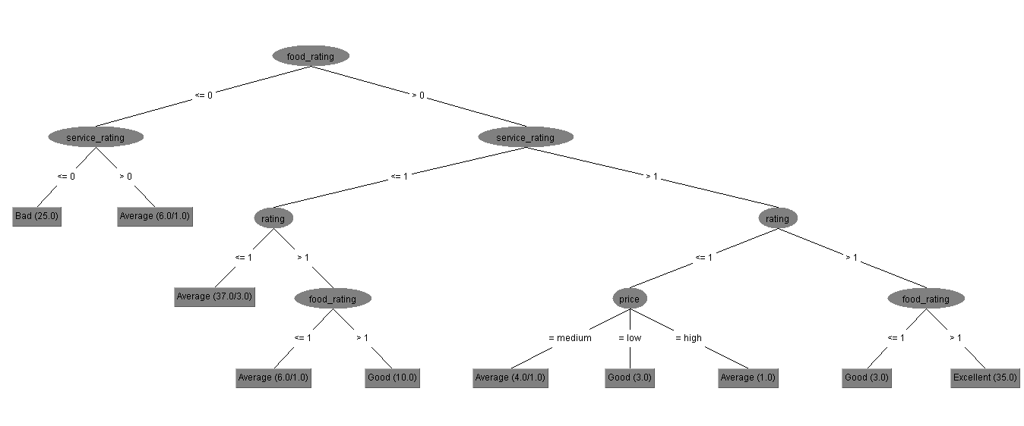
Tree for the Datasets

Slide 12
Conclusion
In the end this application would have provided the customer satisfaction needed for the restaurants leading to the customer happiness and increase in the business and revenues.

